Slide 1
KSP 5.0
Eclipsing Binaries
Project

Slide 2
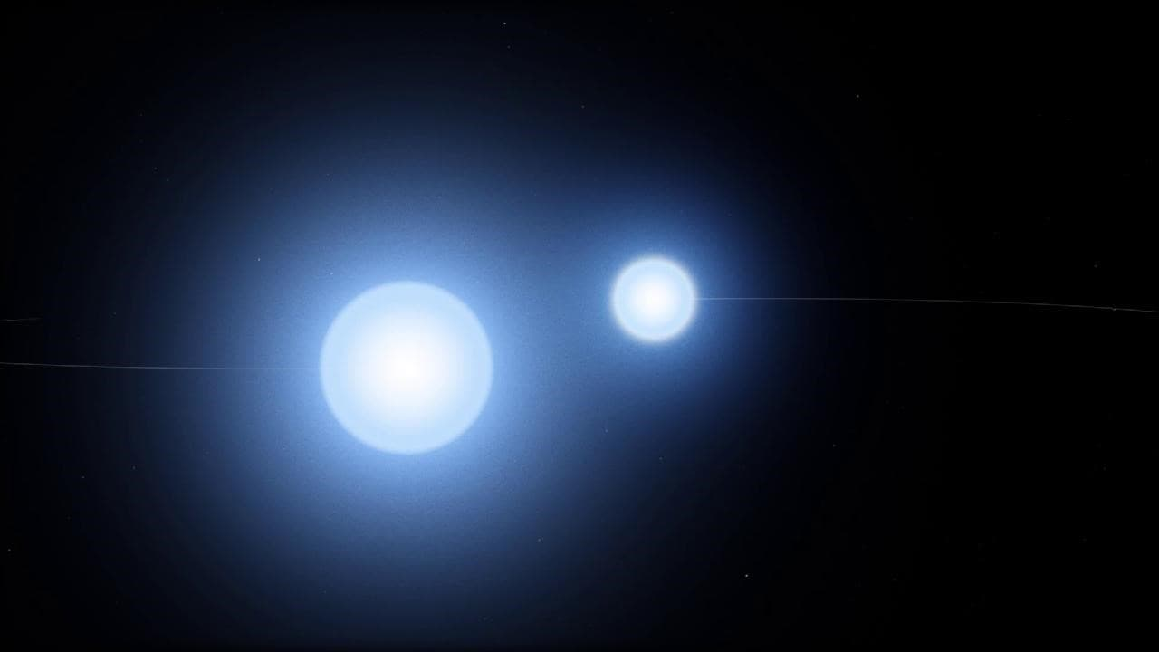
Binary Star Systems

Slide 3
Types of Binary Stars
Visual binaries: Seen directly through telescopes.
Spectroscopic binaries: Identified by periodic shifts in their spectral lines due to their orbital motion.
Eclipsing binaries: Detected by changes in luminosity as one star passes in front of the other.
Astrometric binaries: Detected by observing the wobble in a star's position due to an unseen companion.

Slide 4
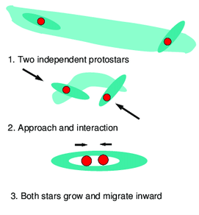
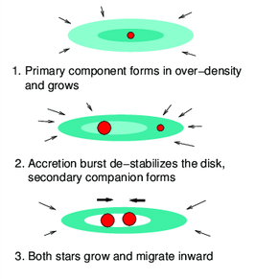
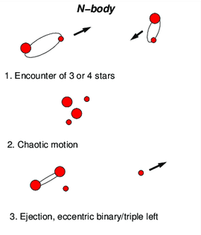
Origins and Formation
Turbulent Fragmentation
Disk Fragmentation
Dynamical Formation

Slide 5
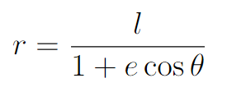
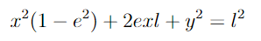
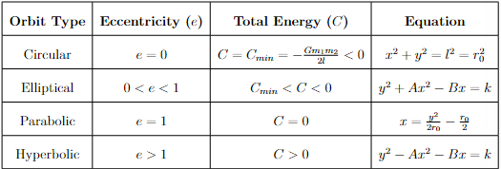
Orbital Mechanics Overview
The Orbit Equation for the reduced body
The general equation for the orbit

Slide 6
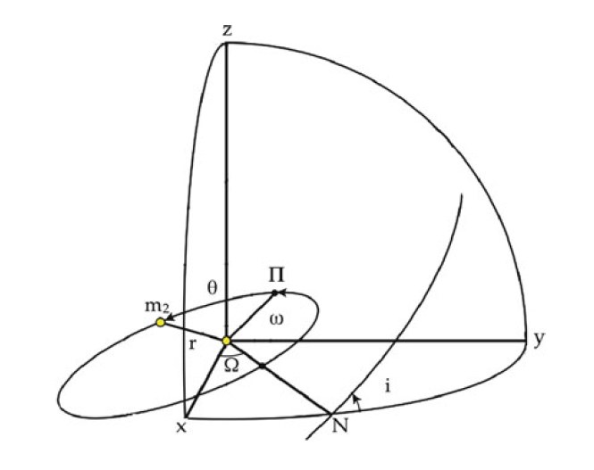
Elliptical Orbits and
Orbital Elements
•Angle of Inclination, i
•Longitude of the ascending node, Ω
•Longitude of the periastron, ω
•Semimajor Axis, a
•Eccentricity, e
•Time of Periastron, T

Slide 7
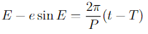
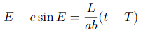
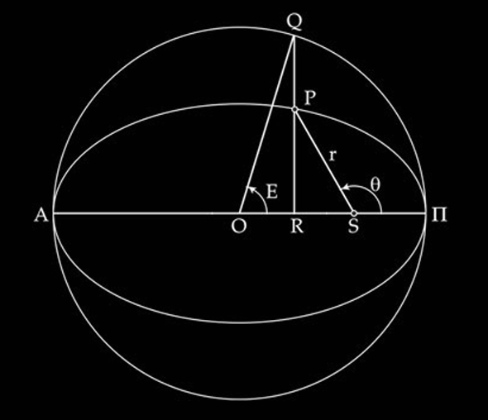
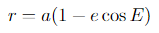
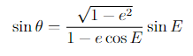
Time Dependence
or
where:

Slide 8
Workflow and Objectives
Our workflow involves several key steps:
Data Collection: Gathering observational data on eclipsing binaries.
Modeling: Using PHOEBE to create detailed models of the binary systems.
Parameter Estimation: Deriving physical parameters from the models.
Analysis: Interpreting the results to enhance our understanding of these systems.

Slide 9
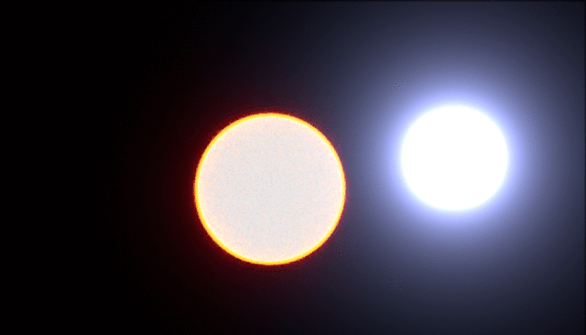
Eclipsing
Binaries

Slide 10
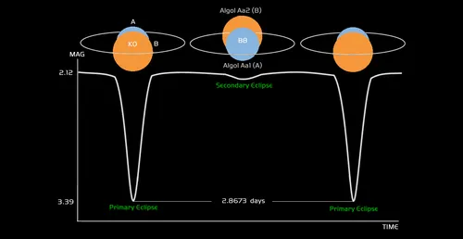
What are Eclipsing Binaries?
Binaries in which the orbital plane of the two stars lies so nearly in the line of sight of the observer that the components undergo mutual eclipses are called Eclipsing Binaries.
They are characterized by periods of constant light, punctuated by periodic drops in intensity when one star passes in front of the other.

Slide 11
Why are Eclipsing Binaries Important?
Eclipsing binaries are important astrophysical objects as they allow astronomers to determine the masses, radii, and other physical properties of the component stars through careful analysis of the light curves and other observational data.
 | Astrometric Binaries |  |  | Spectroscopic Binaries |  | Eclipsing Binaries
 | alone | with distance | with RVs | SB1 | SB2 | alone | SB1 | SB2
No. of Retrievable Parameters | 7 | 10 | 20 | 7 | 13 | 5 | 10 | 27

Slide 12
Types of Eclipsing Binaries
Detached: Well-separated stars with minimal interaction.
Semi-detached: One star fills its Roche lobe, transferring mass
Overcontact: Close binary with tidally distorted stars, potentially sharing a common atmosphere

Slide 13


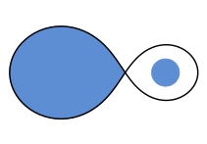
Types of Eclipsing Binary Stars
Detached
Semi-Detached
OverContact

Slide 14

PHOEBE

Slide 15
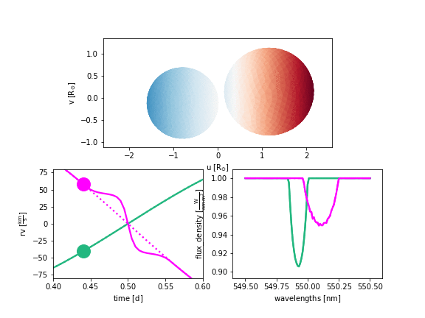
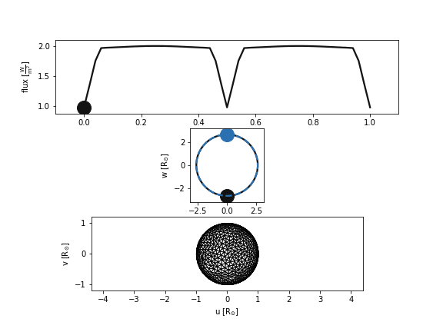
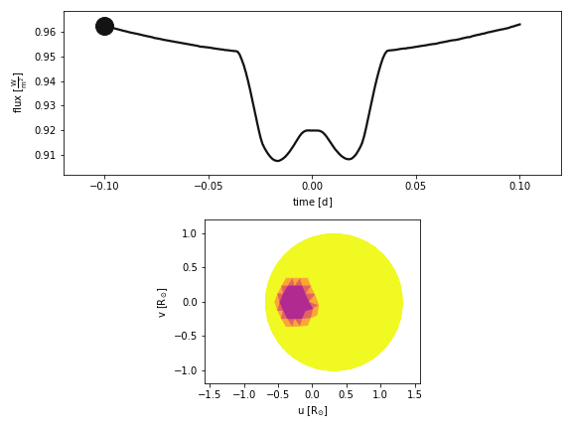
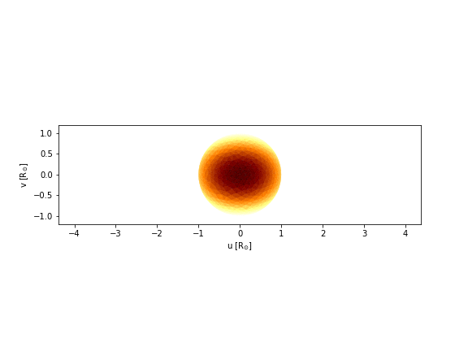
PHOEBE (PHysics Of Eclipsing BinariEs)
A powerful and versatile Python package designed specifically for the analysis and modeling of eclipsing binary stars.

Slide 16
PHOEBE Basics
Datasets - PHOEBE interfaces data through datasets. These datasets can contain actual observations or they can simply parametrize the forward-model observable that PHOEBE can synthesize.
Datasets supported
Light Curve
Radial Velocity Curve
Light Profile
Orbit
Mesh

Slide 17
PHOEBE Basics
Compute - In Phoebe, Compute typically refers to the process of calculating or processing data. We can compute different types of parameters using Compute
In Phoebe added datasets.
Times - This refers to the specific moments or timestamps at which observations are made. In light curve analysis, Times are the x-axis values representing when the observations were recorded.
Phases - Phases are used to represent the position within the orbital cycle of a celestial object. They are often derived from the times of observations using the orbital period of the system.

Slide 18
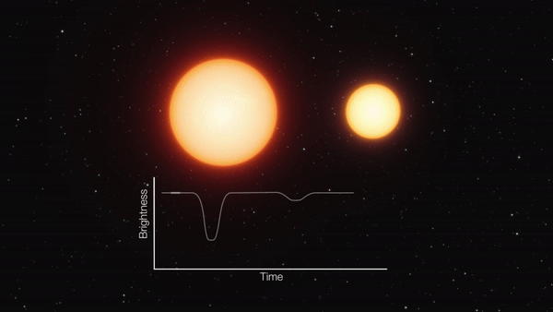
FORWARD MODELING

Slide 19
What Is Forward Modeling?
Why is Forward Modeling used?
Forward Modeling is essentially the simulation of a real-world process.
Forward modeling has many application such as
understanding the relationship between causes and effects.
Testing theoretical models and improving them.
Forecasting future events which Sometimes results in unexpected features in the observed light curve, hinting at new physical processes.
Why is PHOEBE used for Forward Modeling of Eclipsing Binaries?
It provides us with a comprehensive toolkit for simulating and interpreting the complex interactions between binary star systems.

Slide 20
Key Steps in Forward Modeling for Eclipsing Binaries
Orbital Elements
Light Curve Dataset
Faster , less accurate model
Light curve
Defining System Parameters
Adding dataset
Computing
Plotting
Parameters of the stars
Radial Velocity
Dataset
Slower, more accurate model
Radial
Velocity
Mesh

Slide 21
Initial setup
>>> import phoebe
>>> b = phoebe.default_binary()
Defining System Parameters
>>>b.set_value()
Adding dataset
>>>b.add_dataset()
Computing
>>>b.run_compute()
Plotting
>>>afig, mplfig = b.plot(show=True)

Slide 22
Inverse Problem

Slide 23
What is an Inverse Problem ?
In the context of Eclipsing Binaries, inverse problem involves determining the underlying orbital parameters and stellar parameters based on the observational data, in the form of light and radial velocity curves.
​​Fitting EBs, is anything but straightforward, and the root cause of that is the complexity of the parameter space

Slide 24
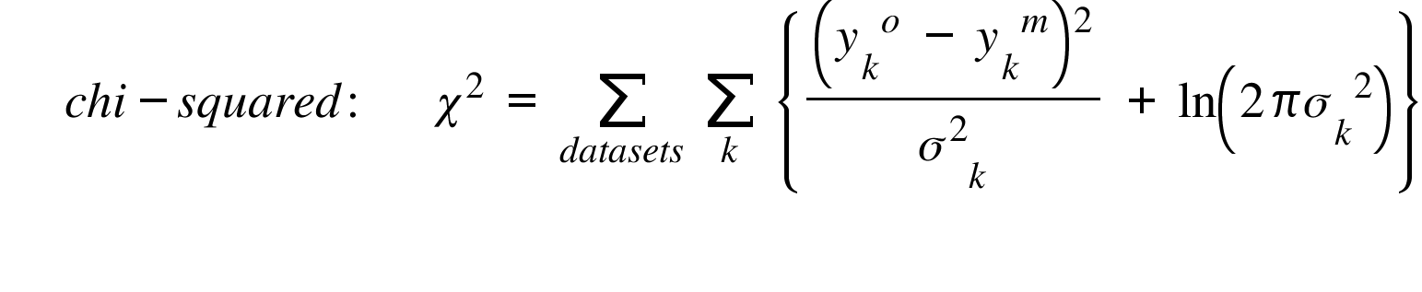
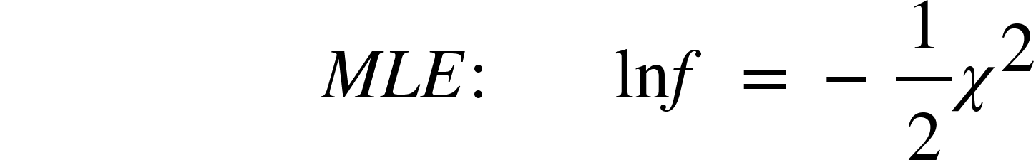
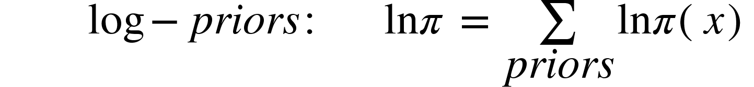
Merit Function

Slide 25
Phoetting Recipe
Local Optimizers
(NMS, Powell, CG, DC)
MCMC
(emcee)
Periodograms
EBAI
Estimate
Optimize
Sample
RV Geometry
LC Geometry
Global Optimizers
(DE)
Nested Sampling
(dynesty)

Slide 26
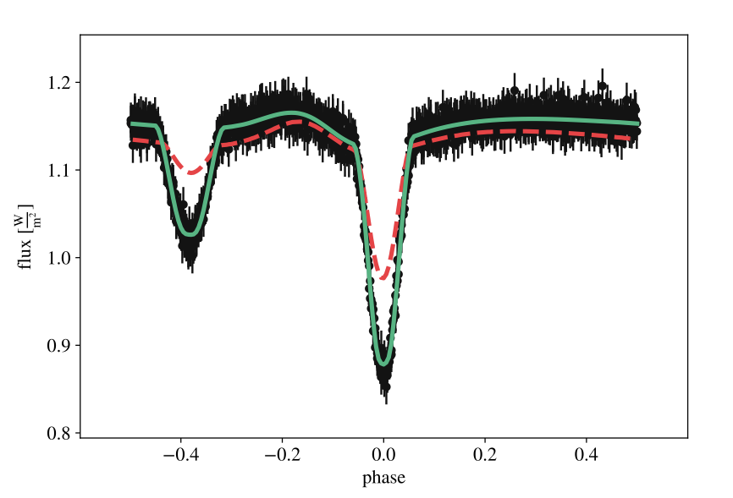
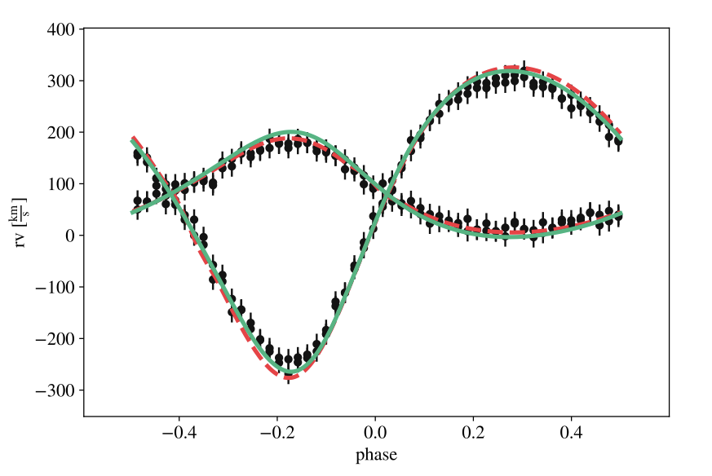
Model improvement after adopting proposals from estimators (dashed red lines) and after running Nelder-Mead (solid green lines)

Slide 27
>>> import phoebe
>>> b = phoebe.default_binary()
>>> b.add_dataset(‘lc’, times = times, fluxes = fluxes, sigmas = lc_sigmas)
>>> b.add_solver(‘estimator.lc_periodogram’, algorithm = ‘bls’, solver = ‘p_est’)
>>> b.run_solver(‘p_est’, solution = ‘periodogram’)
>>> b.adopt_solution(‘periodogram’)
>>> b.add_solver(‘optimizer.nelder-mead’, solver = ‘nms’)
>>> b[‘fit_parameters@nms’] = [‘teffratio’, ‘requivsumfrac’, ‘requivratio’]
>>> b.run_solver(‘nms’, solution = ‘nm_sol’)
>>> b.adopt_solution(‘nms_sol’)

Slide 28
THANK YOU

